Slide 1
EASY TRAITS ISADORA FLUCK MICHELLE RAMIREZ EKATERINA NEPOVINNYKH S M RAYEED JENNIFER GIRÓN DHANYAPRIYA SOMASUNDARAM HOJIN YOO SYDNE RECORD

Slide 2
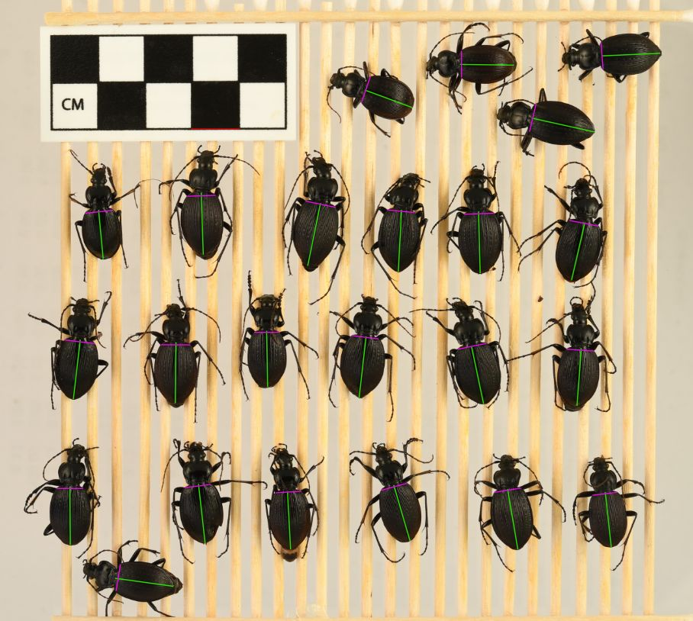
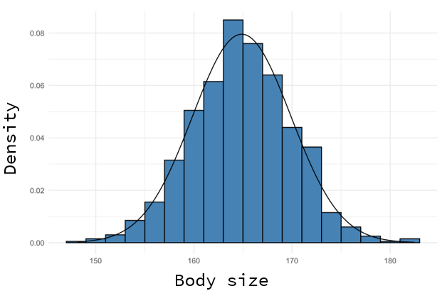
WHY?

Slide 3
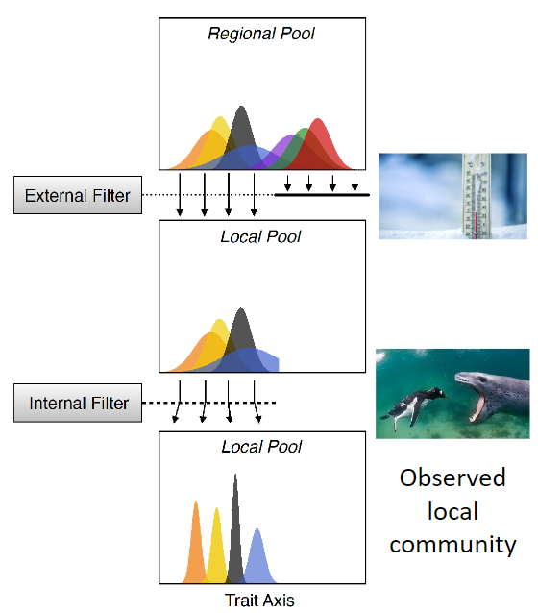
WHY?

Slide 4
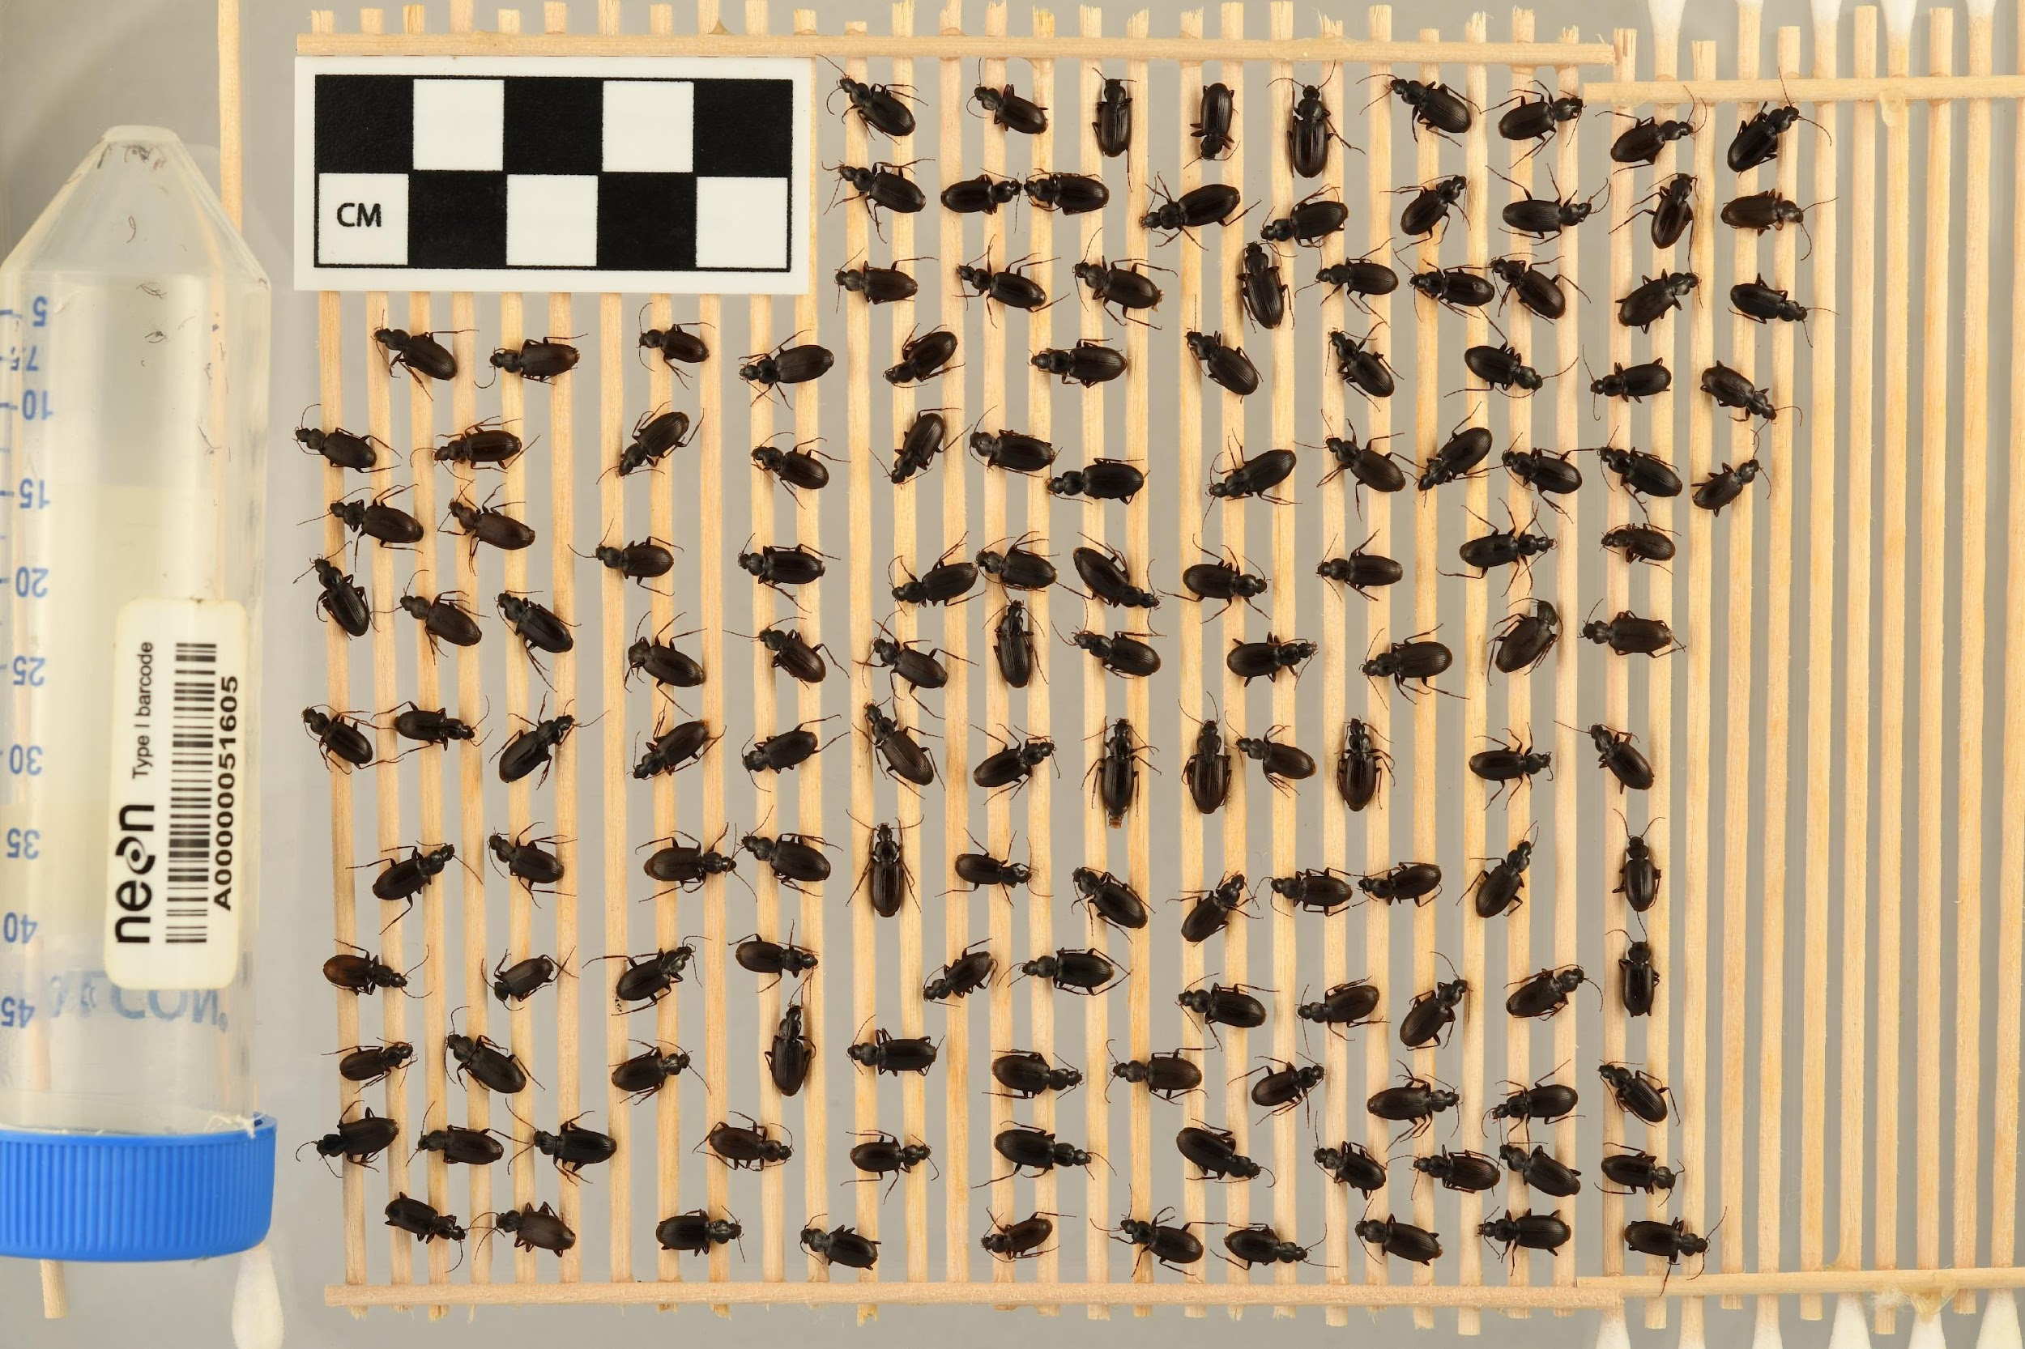
THE CHALLENGE

Slide 5

THE CHALLENGE

Slide 6


THE CHALLENGE

Slide 7
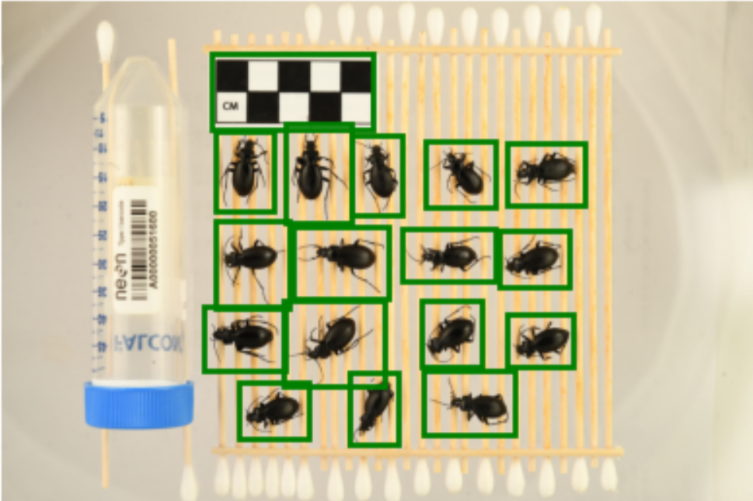
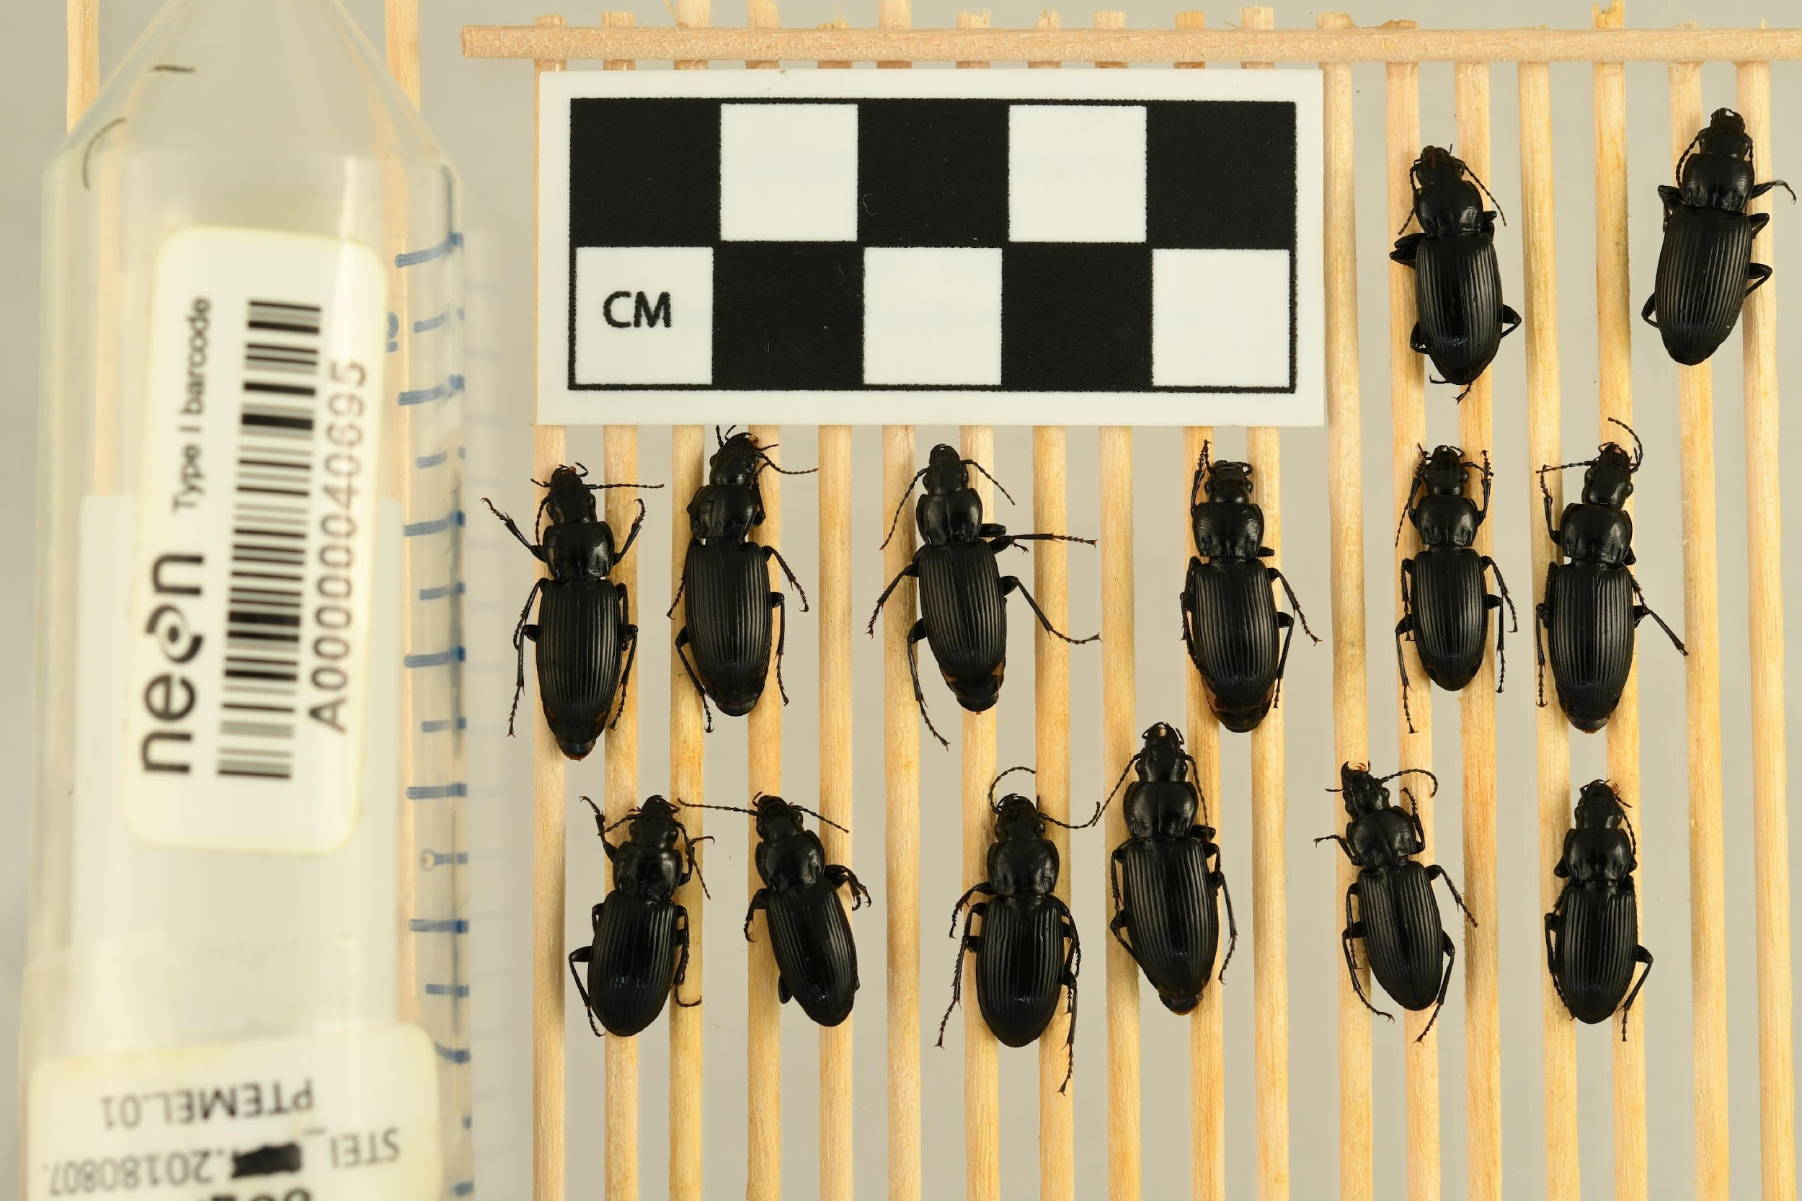
WHAT WE DID – 1 ISOLATE BEETLE AND BAR (MODEL TRAINING)

Slide 8
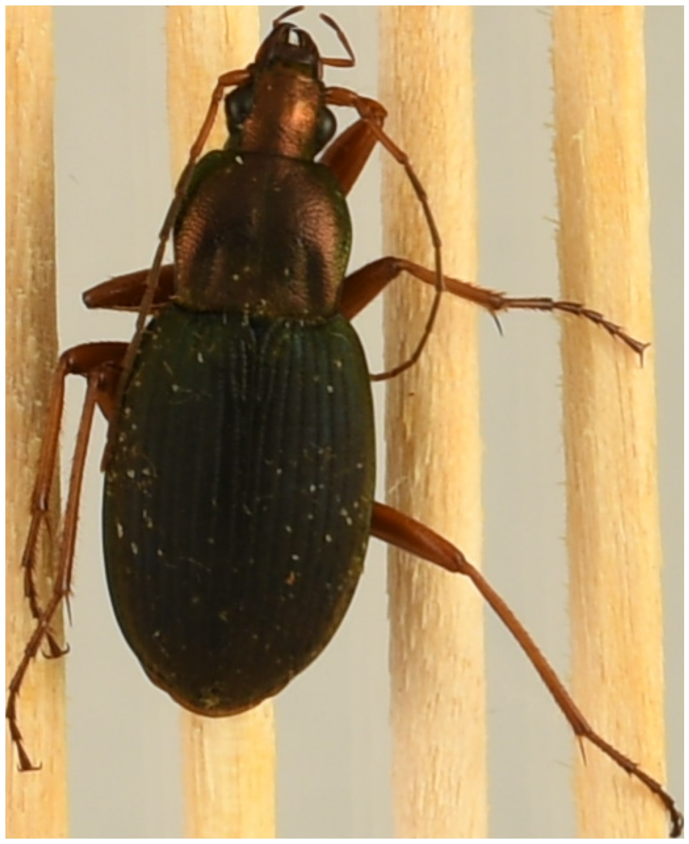
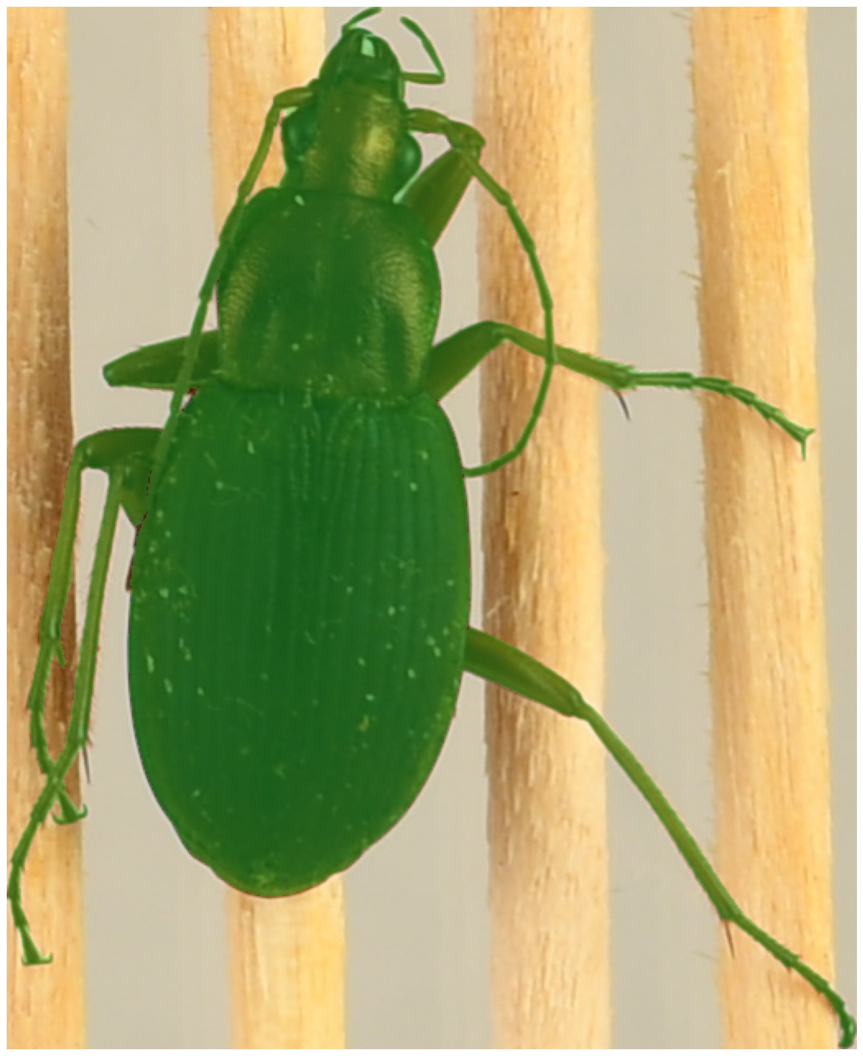
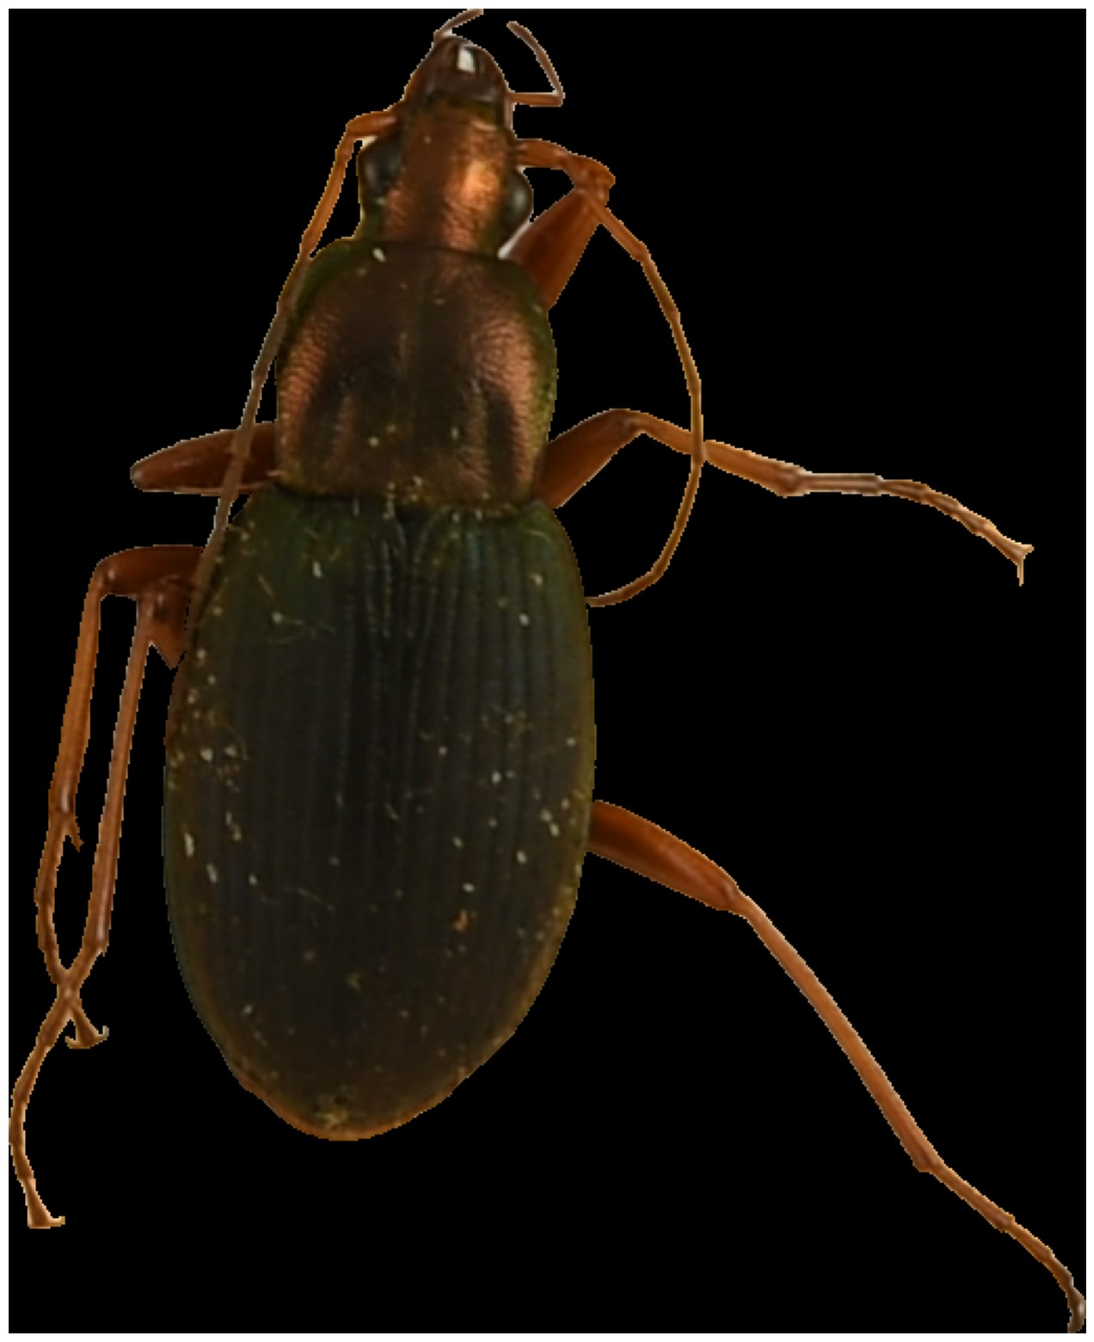
WHAT WE DID – 2 SEGMENT BEETLE (SAM – SEGMENT ANYTHING MODEL)

Slide 9
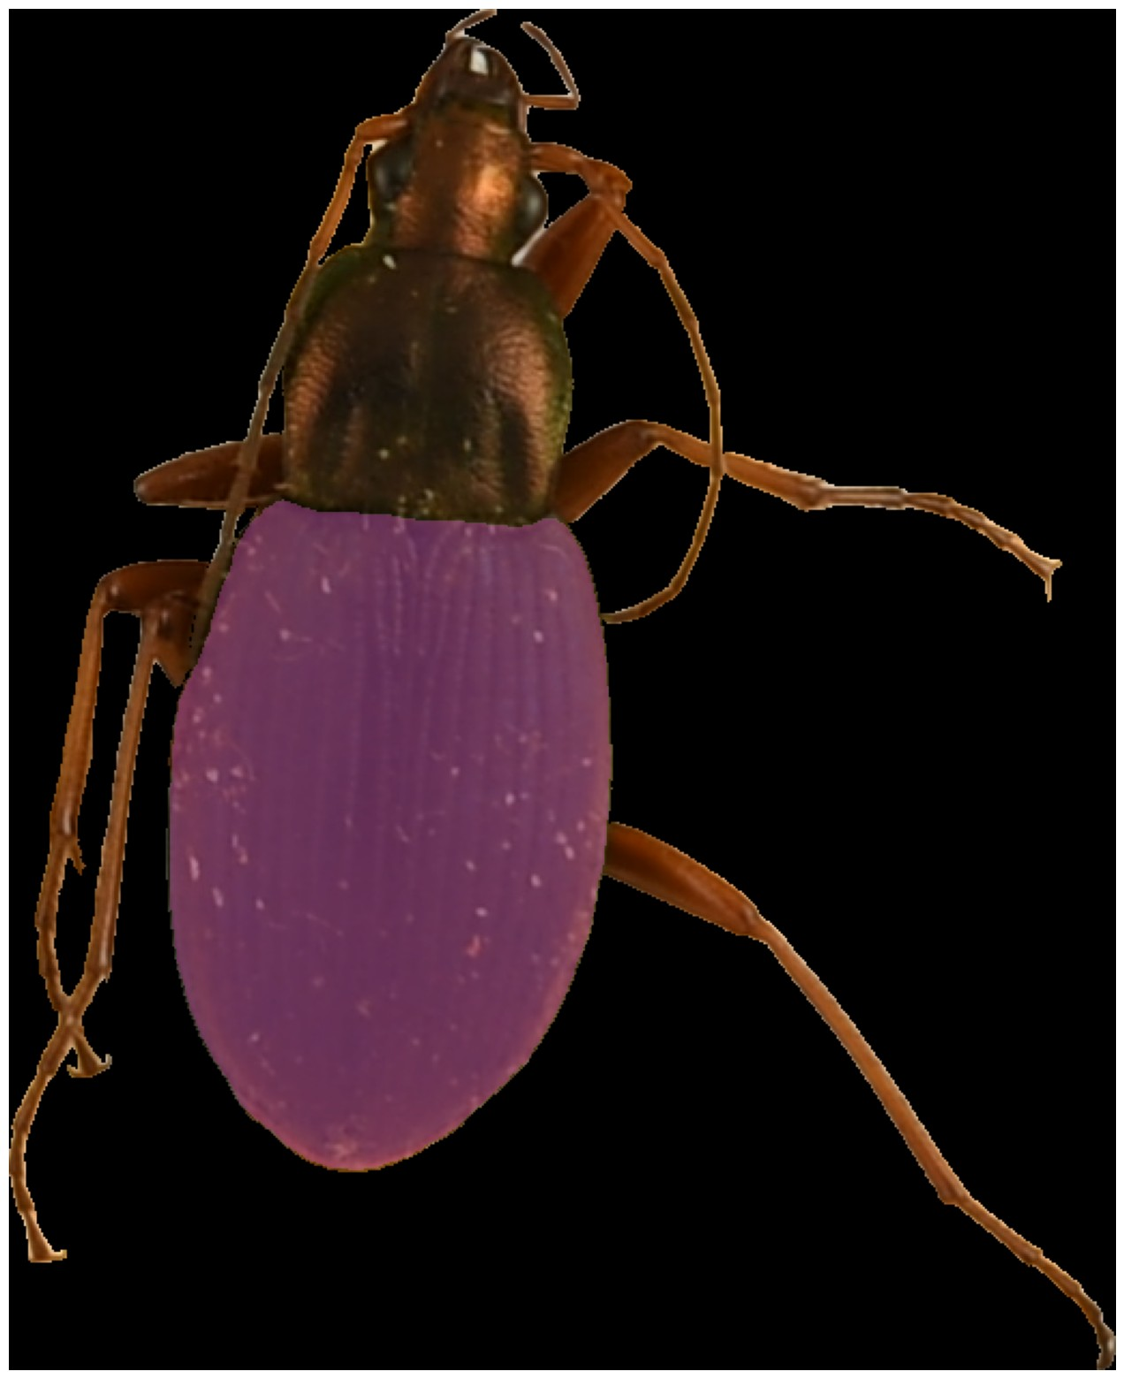
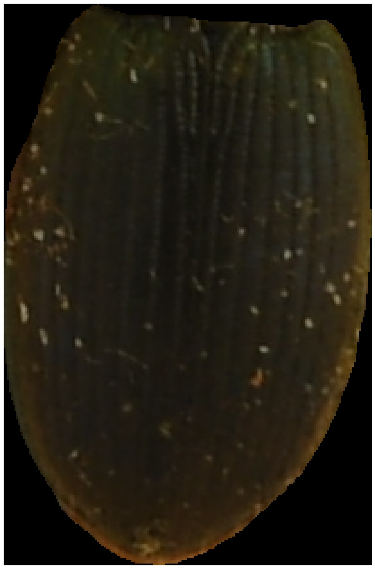
WHAT WE DID – 3 SEGMENT ELYTRA (SAM – SEGMENT ANYTHING MODEL)
WHAT WE DID – 4 RECTANGLE ELYTRA (SAM – SEGMENT ANYTHING MODEL)

Slide 10
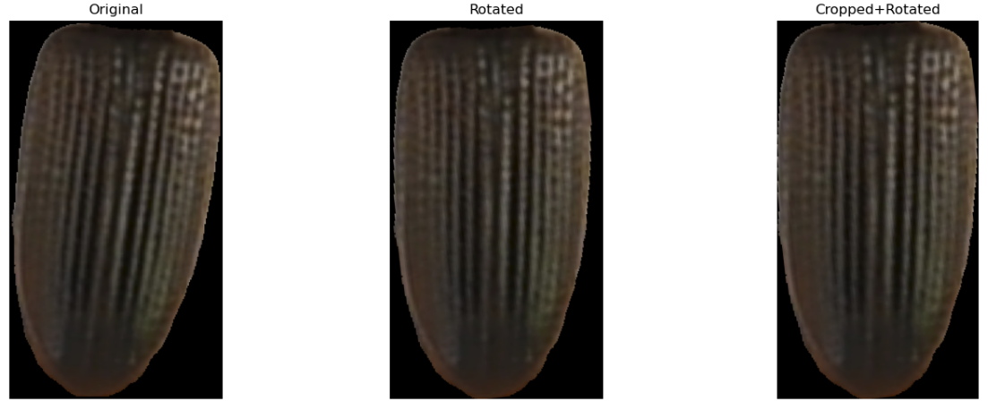
WHAT WE DID – 5 ROTATE VERTICALLY (OPTIMIZE RECTANGLE AREA)

Slide 11
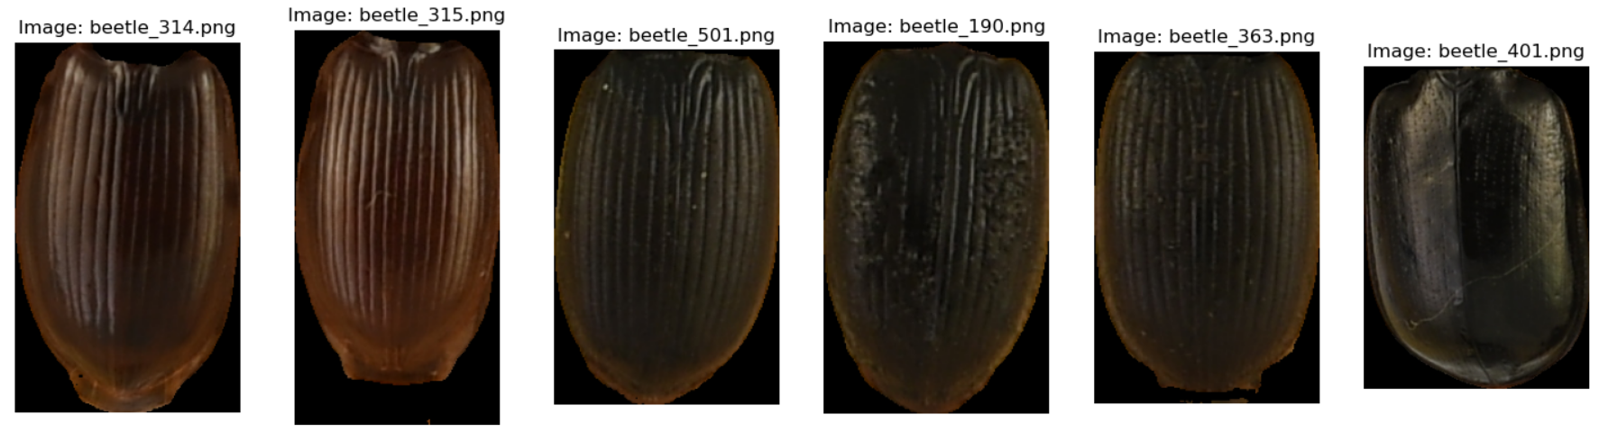
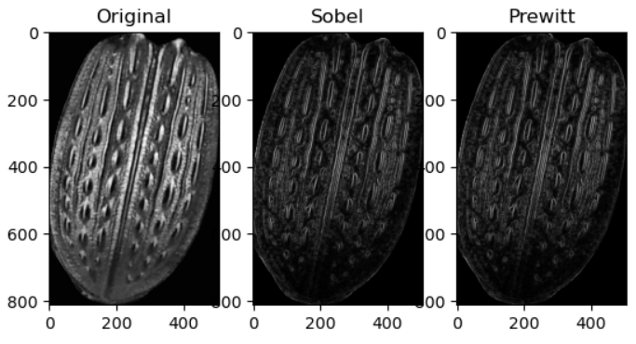
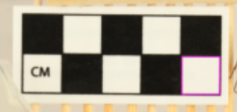
WHAT WE DID – 6 - EDGE DETECTION (PREWITT)
WORK THE BEST: CANNY, SOBEL, PREWITT
FROM ALL EDGES EXTRACT THE CONTOURS AND KEEP THE LARGEST ONE (“PERIMETER”)

Slide 12
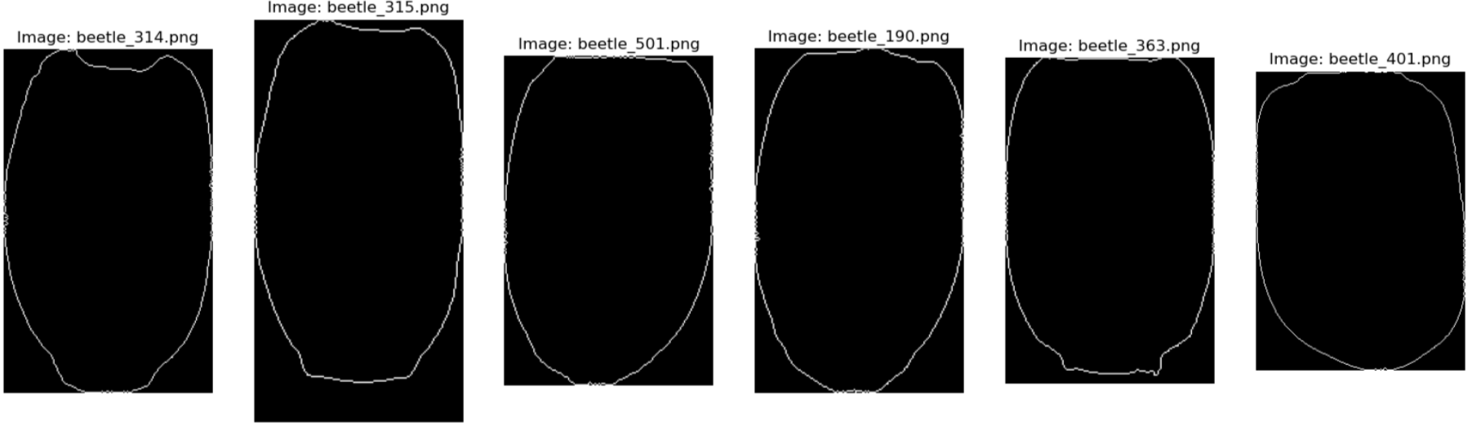
WHAT WE DID – 6 - EDGE DETECTION (PREWITT)

Slide 13
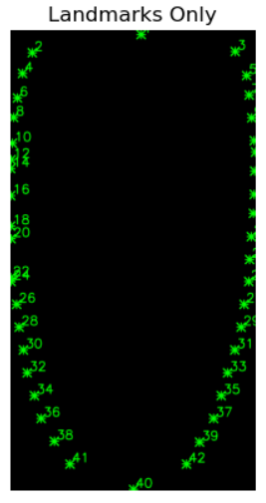
WHAT WE DID – 7 “LANDMARKS”
CUSTOM LANDMARKS FROM THE LARGEST CONTOUR

Slide 14
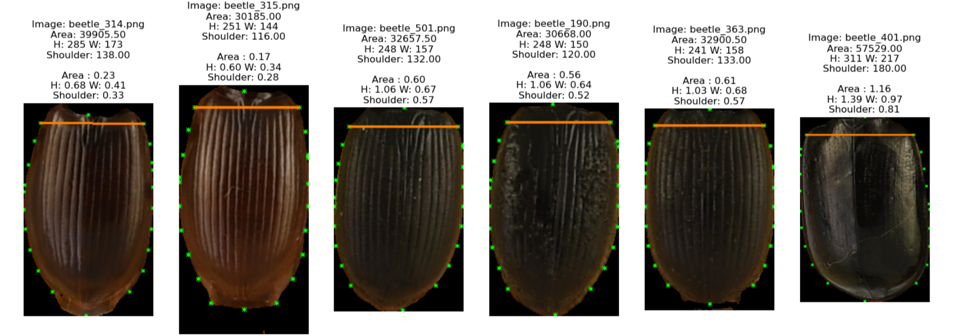
WHAT WE DID – 8 PIXEL TO CM (TRAIT MEASURES!)

Slide 15
WHAT WE DID – 8 PIXEL TO CM (TRAIT MEASURES!)
CODE OF THE INDIVIDUAL ELYTRA:
LINKS TO GROUP (DATA FRAME)

Slide 16
WHAT WE DID – 8 PIXEL TO CM (TRAIT MEASURES!)
CODE OF THE INDIVIDUAL ELYTRA:
LINKS TO GROUP (DATA FRAME)
TRAIT MEASUREMENTS IN PIXELS MAX VERTICAL AND HORIZONTAL DISTANCES

Slide 17
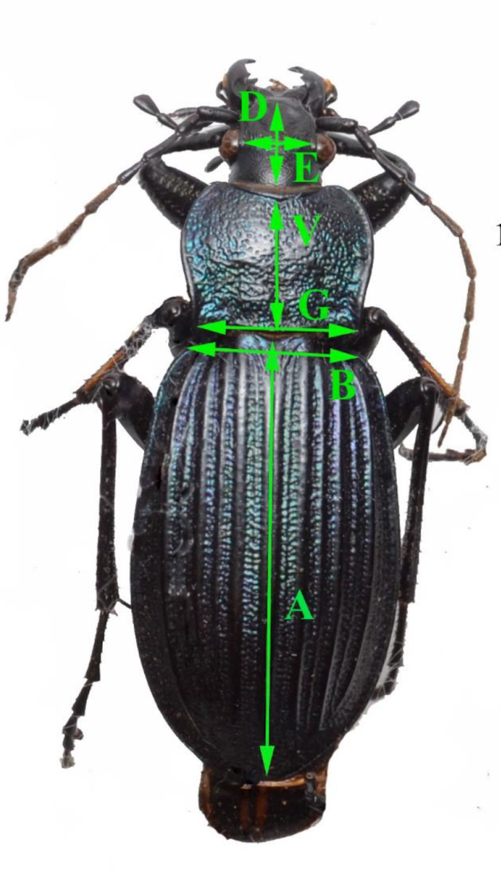
WHAT WE DID – 8 PIXEL TO CM (TRAIT MEASURES!)
CODE OF THE INDIVIDUAL ELYTRA:
LINKS TO GROUP (DATA FRAME)
TRAIT MEASUREMENTS IN PIXELS MAX VERTICAL AND HORIZONTAL DISTANCES

Slide 18
WHAT WE DID – 8 PIXEL TO CM (TRAIT MEASURES!)
CODE OF THE INDIVIDUAL ELYTRA:
LINKS TO GROUP (DATA FRAME)
TRAIT MEASUREMENTS IN PIXELS MAX VERTICAL AND HORIZONTAL DISTANCES

Slide 19
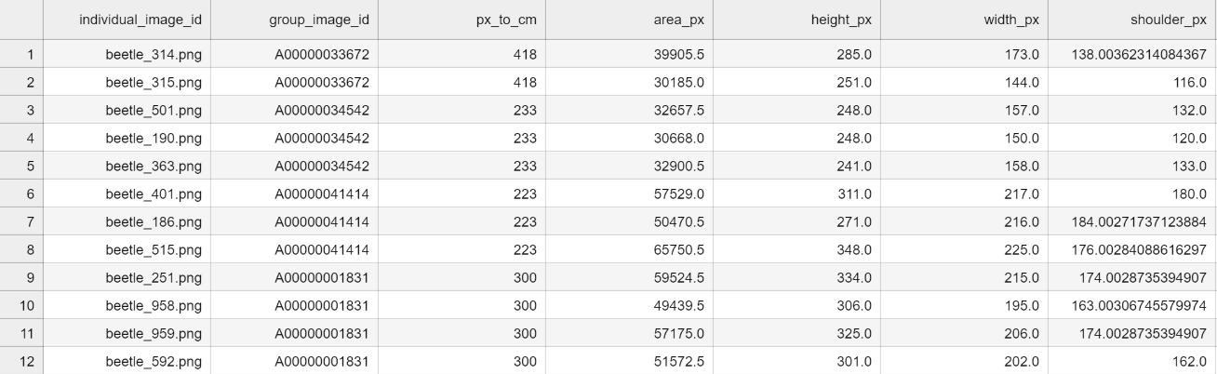
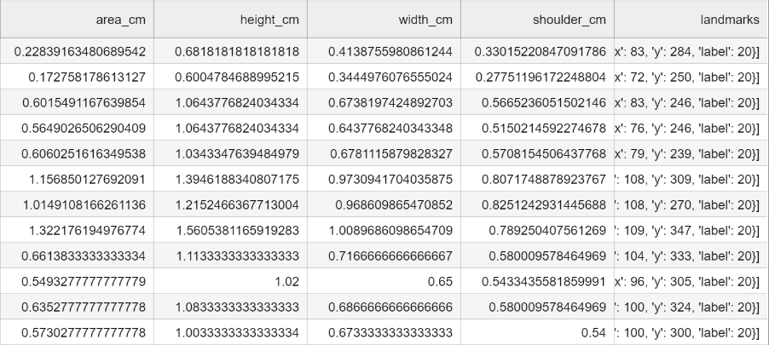

Slide 20
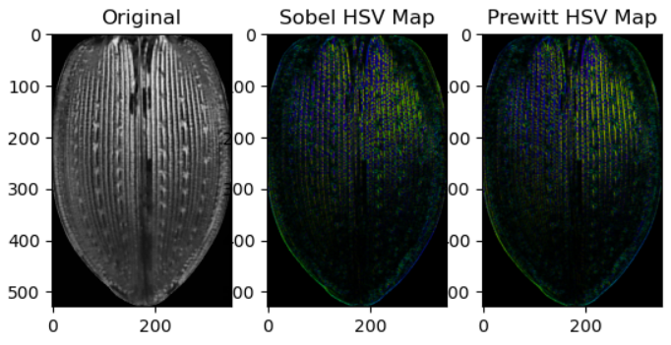
WHAT WE DID – EXTRA!! TEXTURE
HISTOGRAM EQUALIZATION
CLATHE: GET RID OF LIGHT EFFECTS

Slide 21
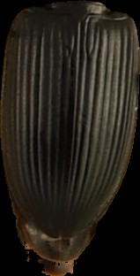
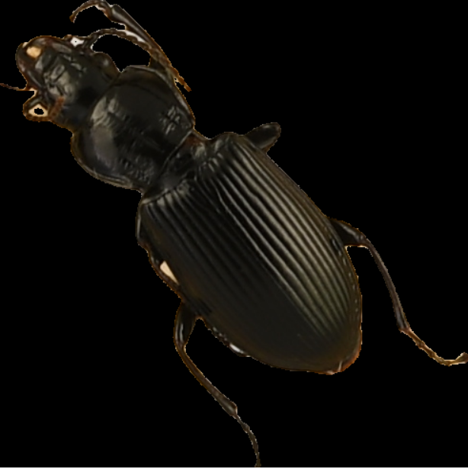
LEFT TO DO
Correct elytra segmentation (Get the elytra that were segmented correctly to create an annotation dataset and train the model)
Apply the “refined” model to all pictures
Compare the results to the measurements made manually
More beetles? (yes please)

Slide 26
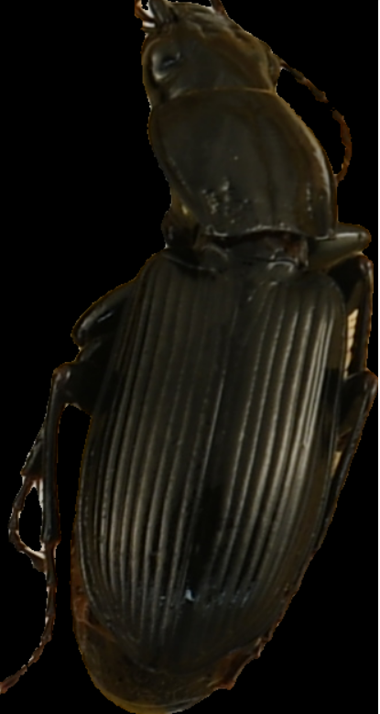
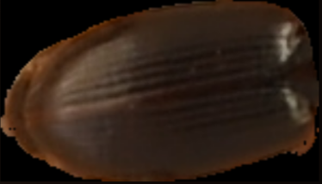
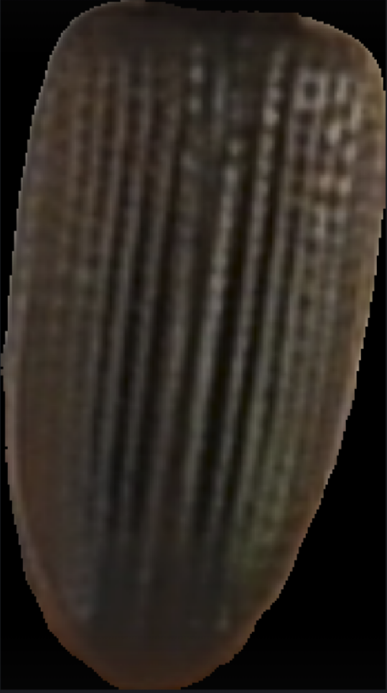
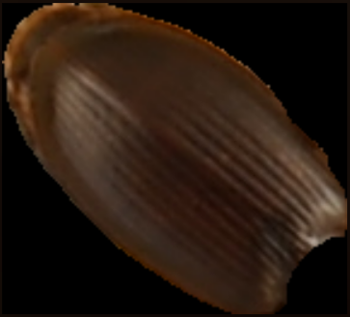
WHAT WE DID

Slide 27
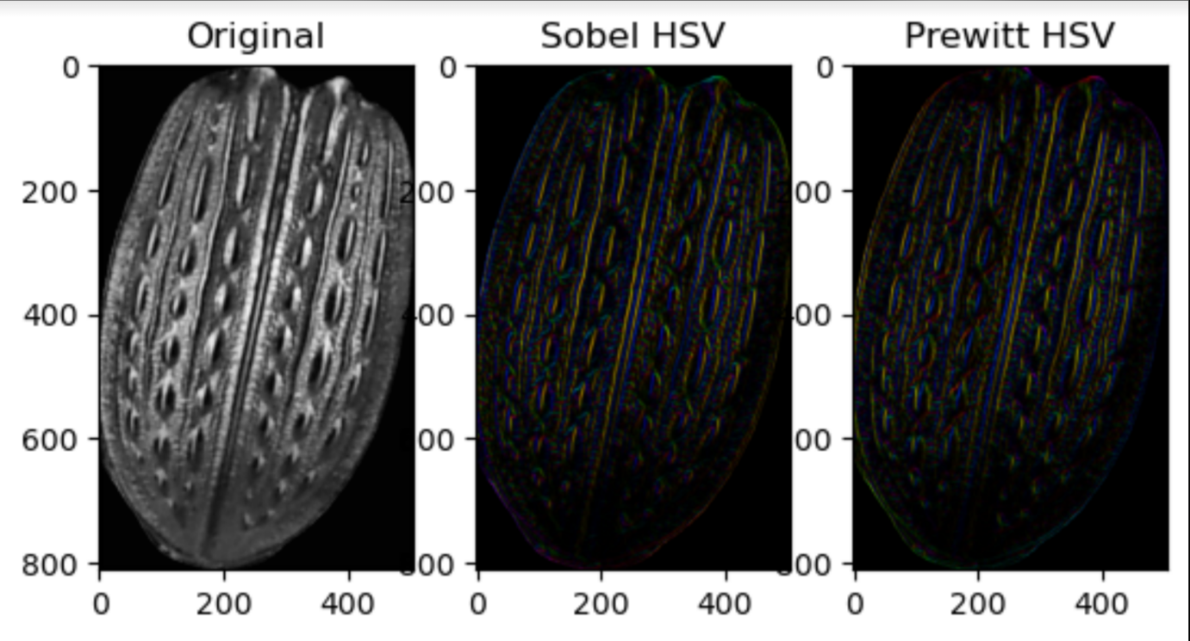
WHAT WE DID

Slide 28
WHAT WE’VE GOT

Slide 29
THE POWER OF COMMUNICATION

Slide 30
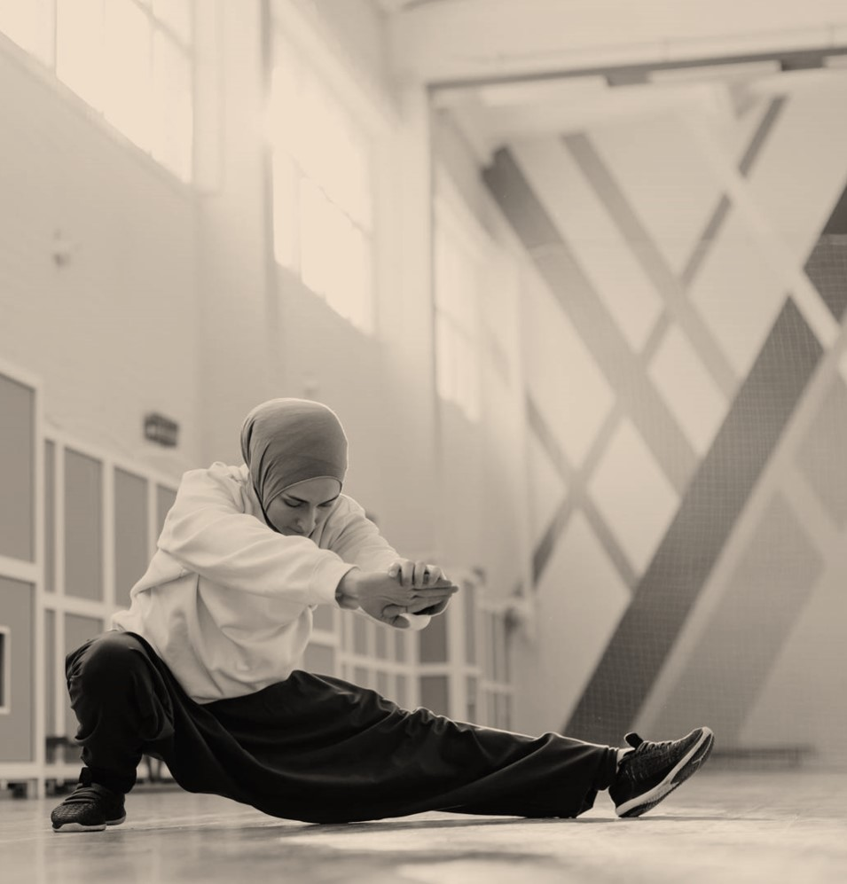
OVERCOMING NERVOUSNESS

Slide 31
ENGAGING THE AUDIENCE
Techniques for connecting
Make eye contact with your audience to create a sense of intimacy and involvement
Weave relatable stories into your presentation using narratives that make your message memorable and impactful
Encourage questions and provide thoughtful responses to enhance audience participation
Use live polls or surveys to gather audience opinions, promoting engagement and making sure the audience feel involved

Slide 32
SELECTING VISUAL AIDS

Slide 33
EFFECTIVE DELIVERY TECHNIQUES
Voice modulation
Body language
This is a powerful tool in public speaking. It involves varying pitch, tone, and volume to convey emotion, emphasize points, and maintain interest:
Pitch variation
Tone inflection
Volume control
Effective body language enhances your message, making it more impactful and memorable:
Meaningful eye contact
Purposeful gestures
Maintain good posture
Control your expressions

Slide 34
NAVIGATING Q&A SESSIONS
Preparing for questions
Maintaining composure
Know your material in advance
Anticipate common questions
Rehearse your responses
Maintaining composure during the Q&A session is essential for projecting confidence and authority. Consider the following tips for staying composed:
Stay calm
Actively listen
Pause and reflect
Maintain eye contact

Slide 35
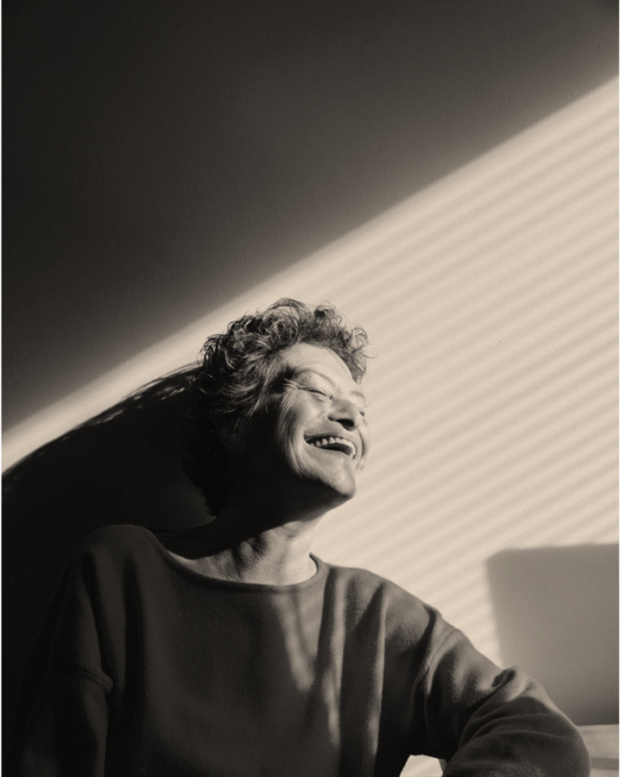
SPEAKING IMPACT
Your ability to communicate effectively will leave a lasting impact on your audience
Effectively communicating involves not only delivering a message but also resonating with the experiences, values, and emotions of those listening

Slide 36
DYNAMIC DELIVERY
METRIC | MEASUREMENT | TARGET | ACTUAL
Audience attendance | # of attendees | 150 | 120
Engagement duration | Minutes | 60 | 75
Q&A interaction | # of questions | 10 | 15
Positive feedback | Percentage (%) | 90 | 95
Rate of information retention | Percentage (%) | 80 | 85
Learn to infuse energy into your delivery to leave a lasting impression
One of the goals of effective communication is to motivate your audience

Slide 37
FINAL TIPS & TAKEAWAYS
Practice makes perfect
Continue improving
Consistent rehearsal
Strengthen your familiarity
Refine delivery style
Pacing, tone, and emphasis
Timing and transitions
Aim for seamless, professional delivery
Practice audience
Enlist colleagues to listen & provide feedback
Seek feedback
Reflect on performance
Explore new techniques
Set personal goals
Iterate and adapt

Slide 38
SPEAKING ENGAGEMENT METRICS
IMPACT FACTOR | MEASUREMENT | TARGET | ACHIEVED
Audience interaction | Percentage (%) | 85 | 88
Knowledge retention | Percentage (%) | 75 | 80
Post-presentation surveys | Average rating | 4.2 | 4.5
Referral rate | Percentage (%) | 10 | 12
Collaboration opportunities | # of opportunities | 8 | 10

Slide 39
THANK YOU
Brita Tamm
502-555-0152
brita@firstupconsultants.com
www.firstupconsultants.com

